Slide 1
Kinderview
A Unique VR Experience

Slide 2
Department of Computing & Technology IQRA UNIVERSITY-2022
Name | Id
Muhammad Hashim | 30203
Aatika Farooqui | 30023
Muhammad Huzaifa | 29275
Supervisor | Mam Sana Yousuf

Slide 3
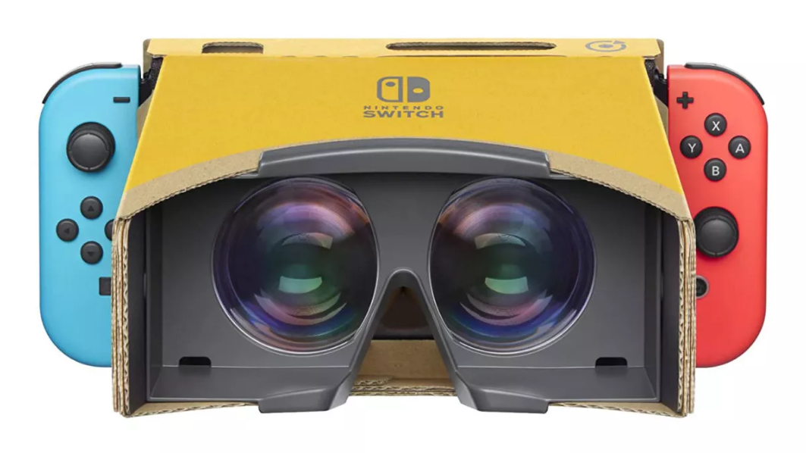
Introduction
A non traditional education method
A unique VR Experience
A Virtual Library of scientific Models
Specially designed & structured for children
3D models from interesting environments

Slide 4
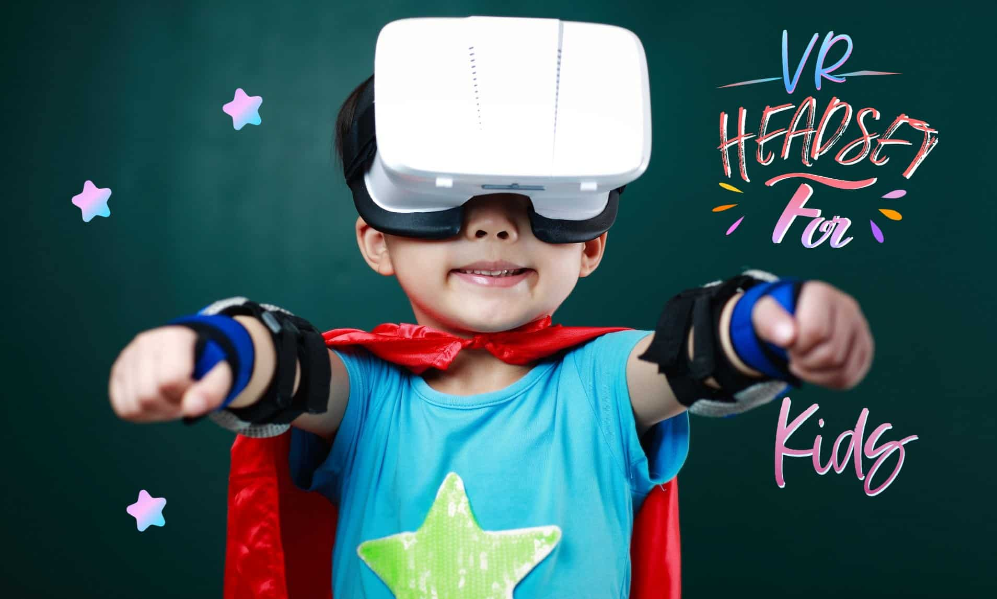
Objectives
To provide 3D models for learning
Visual & Audio aid for efficient learning
To be user friendly for children

Slide 5
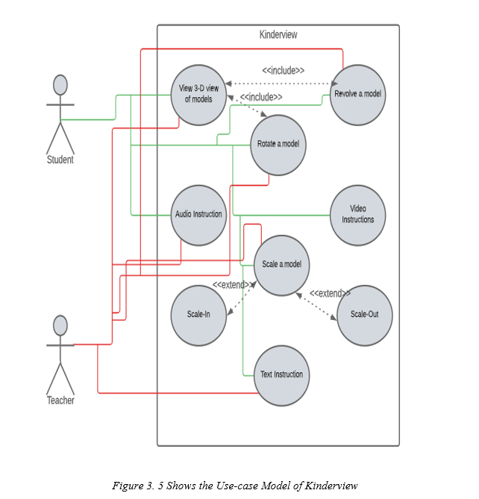
Functional Requirements
3D Models
Model Rotation
Revolving Models
Scaling In & Scaling Out
Text Instructions
Audio & Visual Aid for Instructions

Slide 6
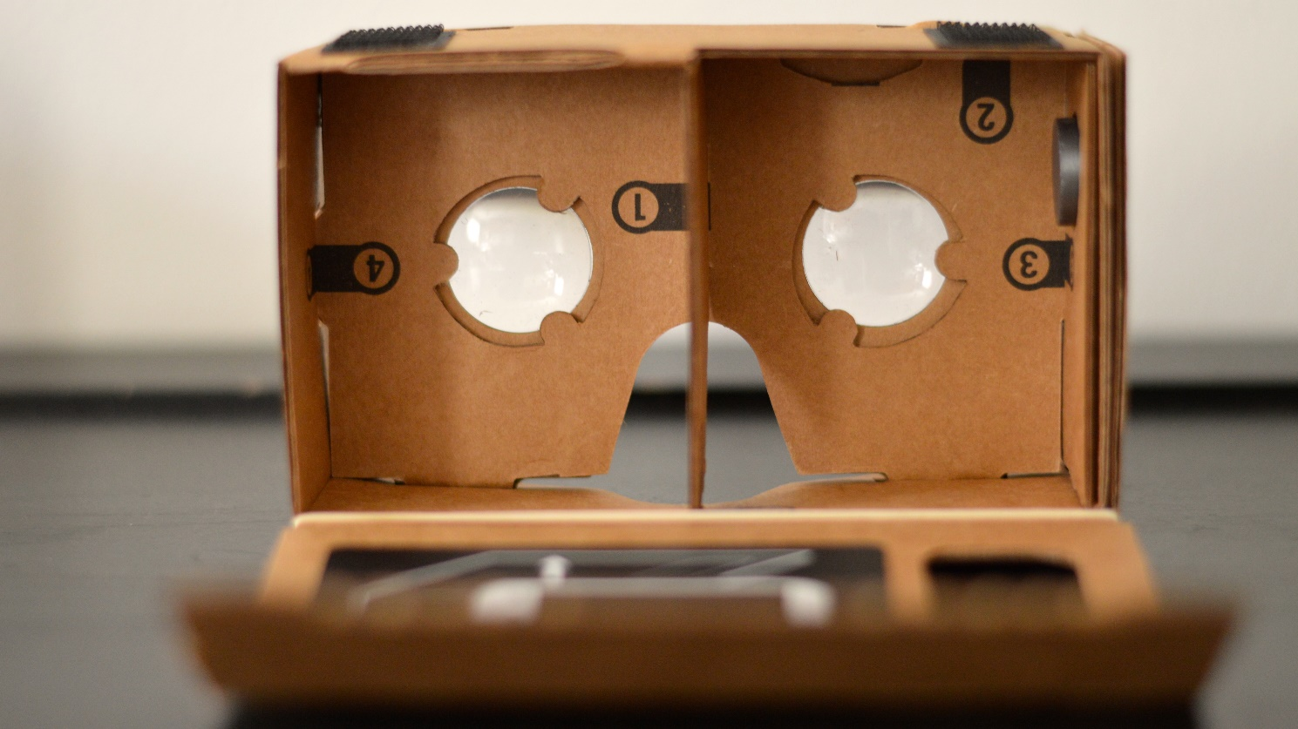
Non-Functional Requirements
Performance Requirements
15-60 FPS required for flawless interaction
Hardware Limitations
VR Headset is necessary for better experience
Smart Phones with greater than 4GB RAM

Slide 7
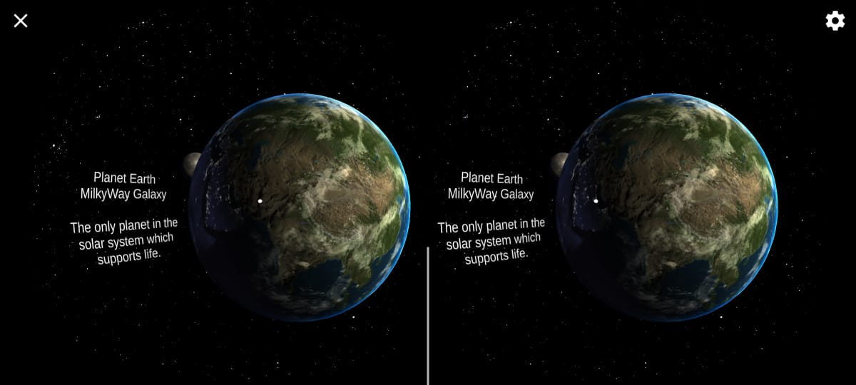
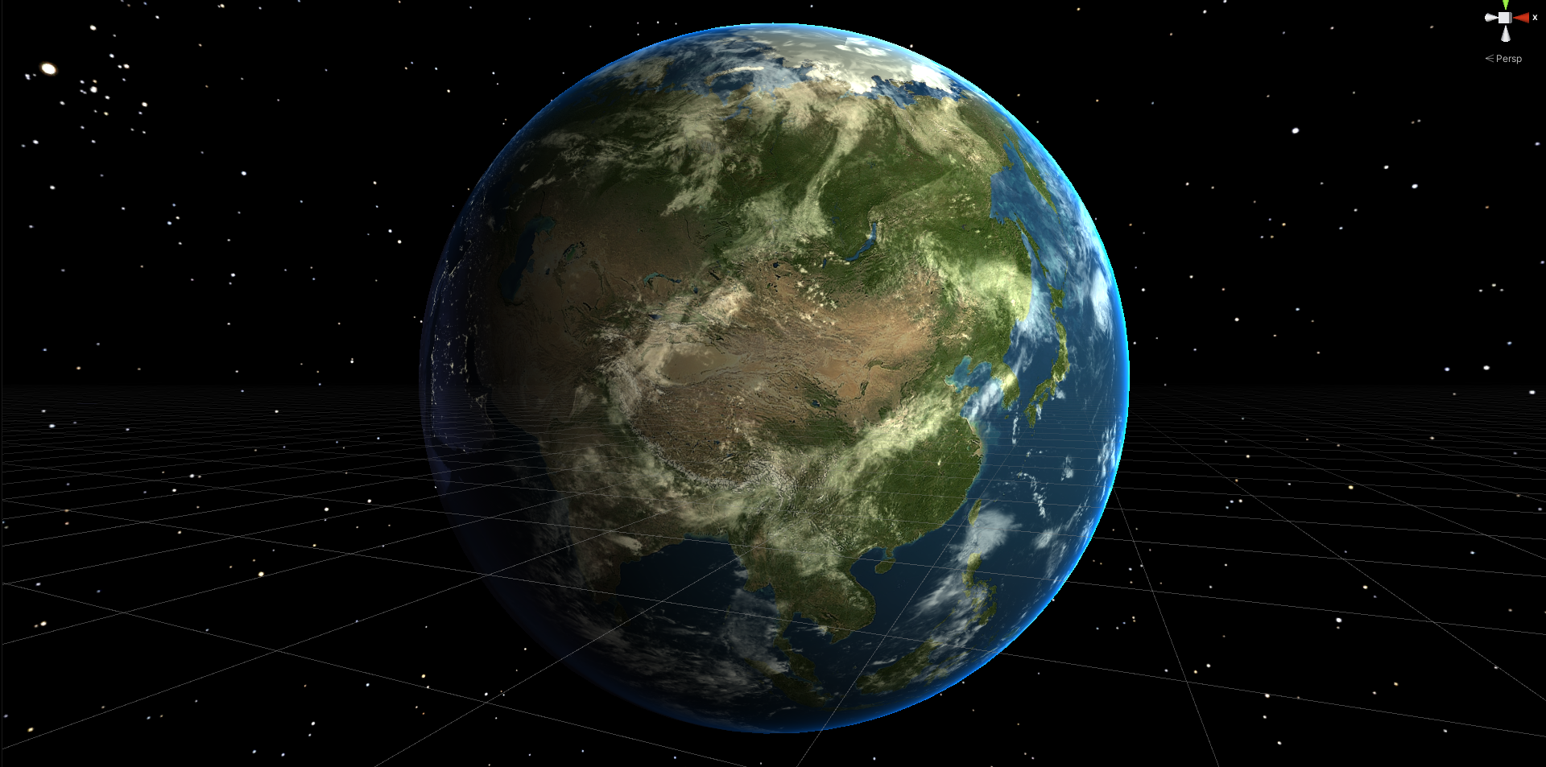
Different Views
Virtual View
in two views, each view for its respective eyeThe virtual view is split
The dual display allow better resolution for proximity view
Normal View
The normal view is how Kinderview will interface normally without VR

Slide 8
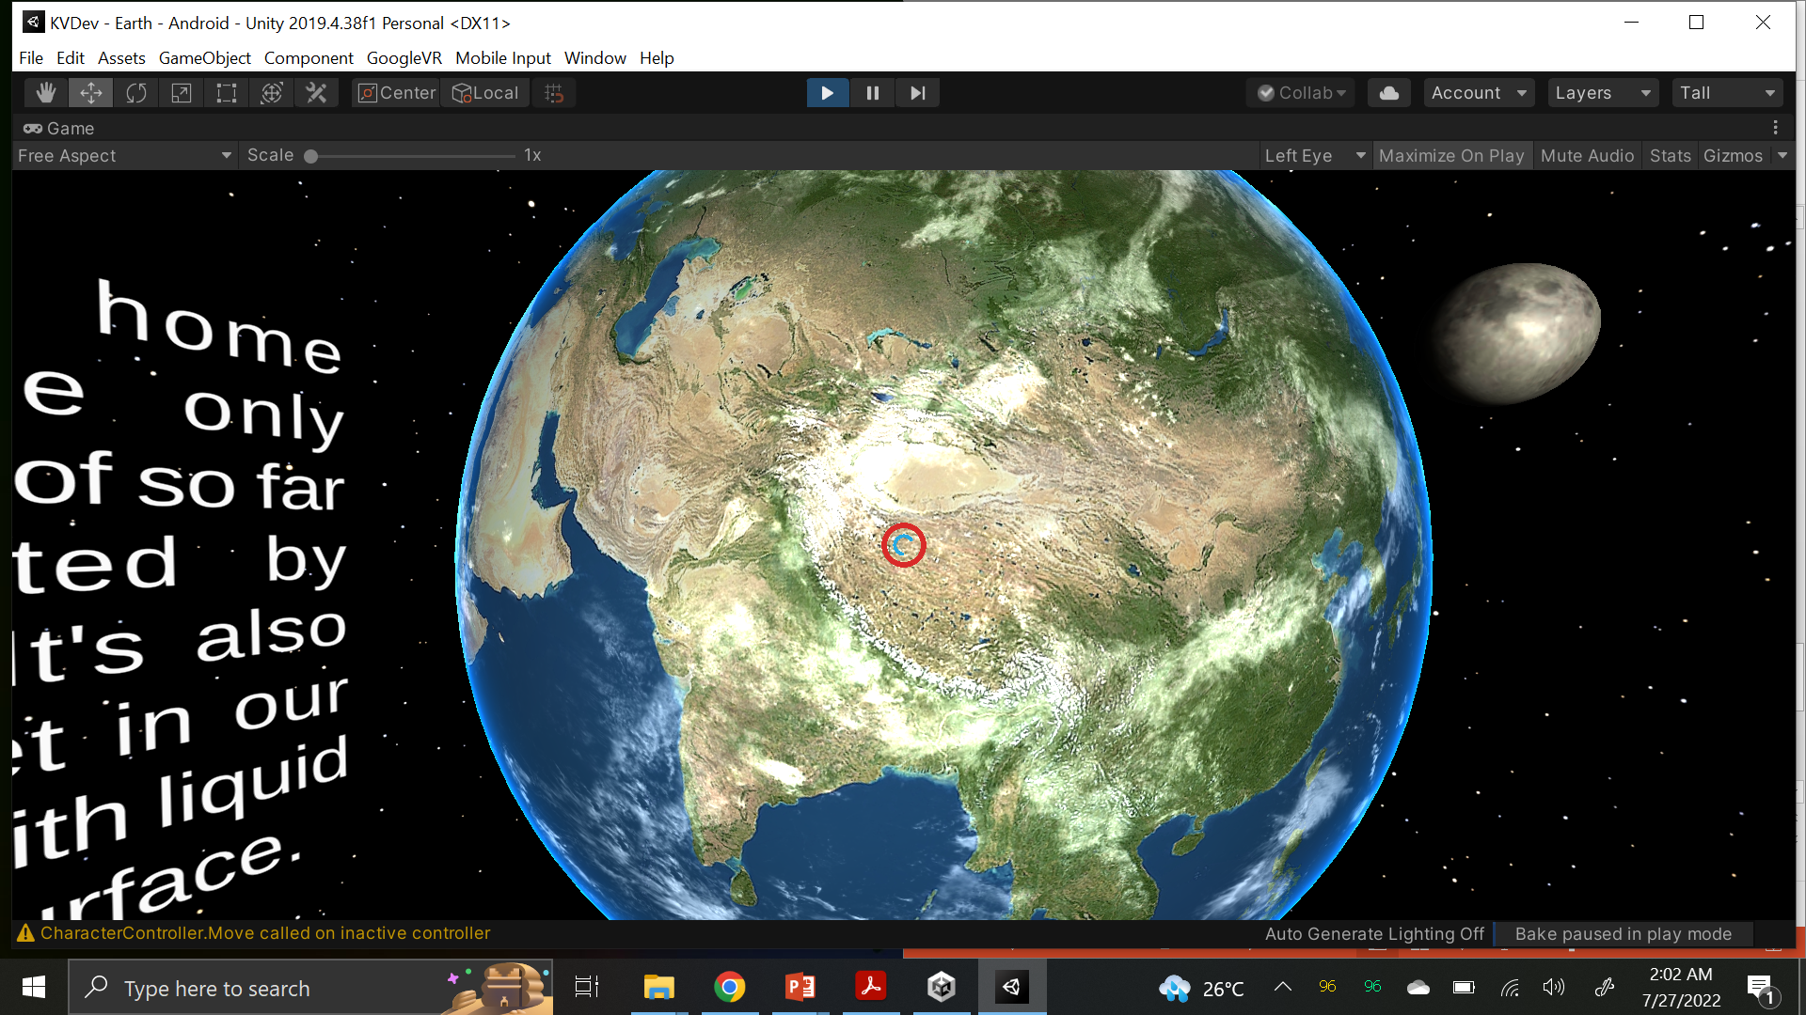
Interface Analysis
Main Model
Secondary Model
Sky-Box
Visual Pointer
Information
Audio Aid

Slide 9
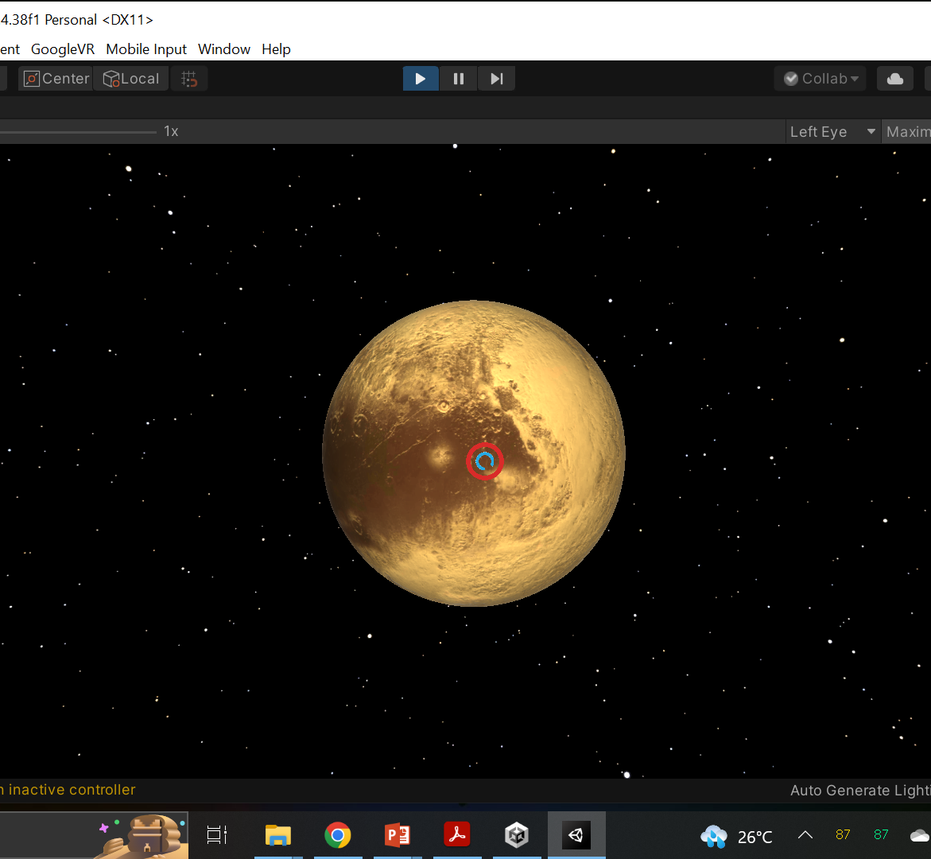
Interaction Method
Reticle
The reticle indicates where the user is pointing/looking.
Timer Indicator
The time indicator is the smaller blue ring in reticle, it gives a sense of time for interaction
Ray-cast
The ray-cast is a invisible ray which determines where the user is pointing/looking
It has a specified range

Slide 10
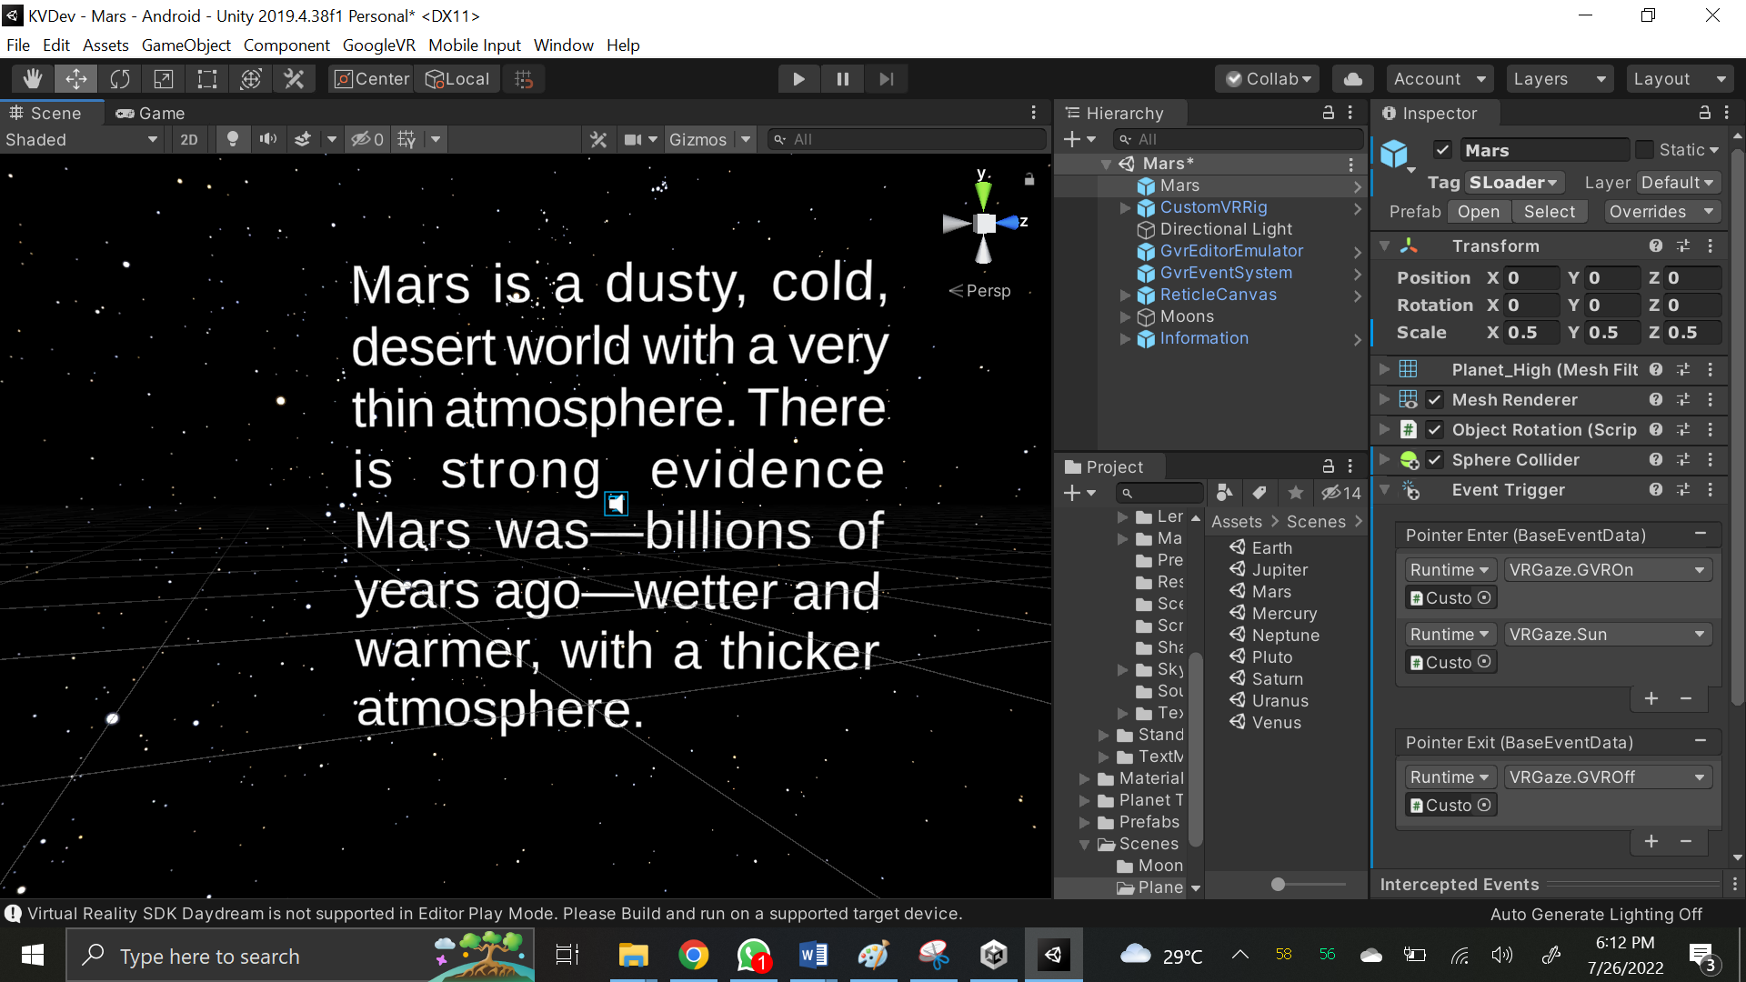
Audio & visual instructions
Audio Instructions
The text object also includes the sound
Upon Looking/Interacting with the text box, a narrator will narrate the text written.
Visual Instructions
The text instruction allows visual information for the user

Slide 11
It’s a wrap
Thank you!

Slide 12
Any Questions…?

